Slide 1
Campus Parking Availability App
Group 8 - KLY Inc.
By: Mohammad Asif, Dylan Capece, Everett McCrea, Luke Padgett, Blake Stroud
Meeting times: Wednesdays at 6:20 pm - Google Hangouts video call

Slide 2



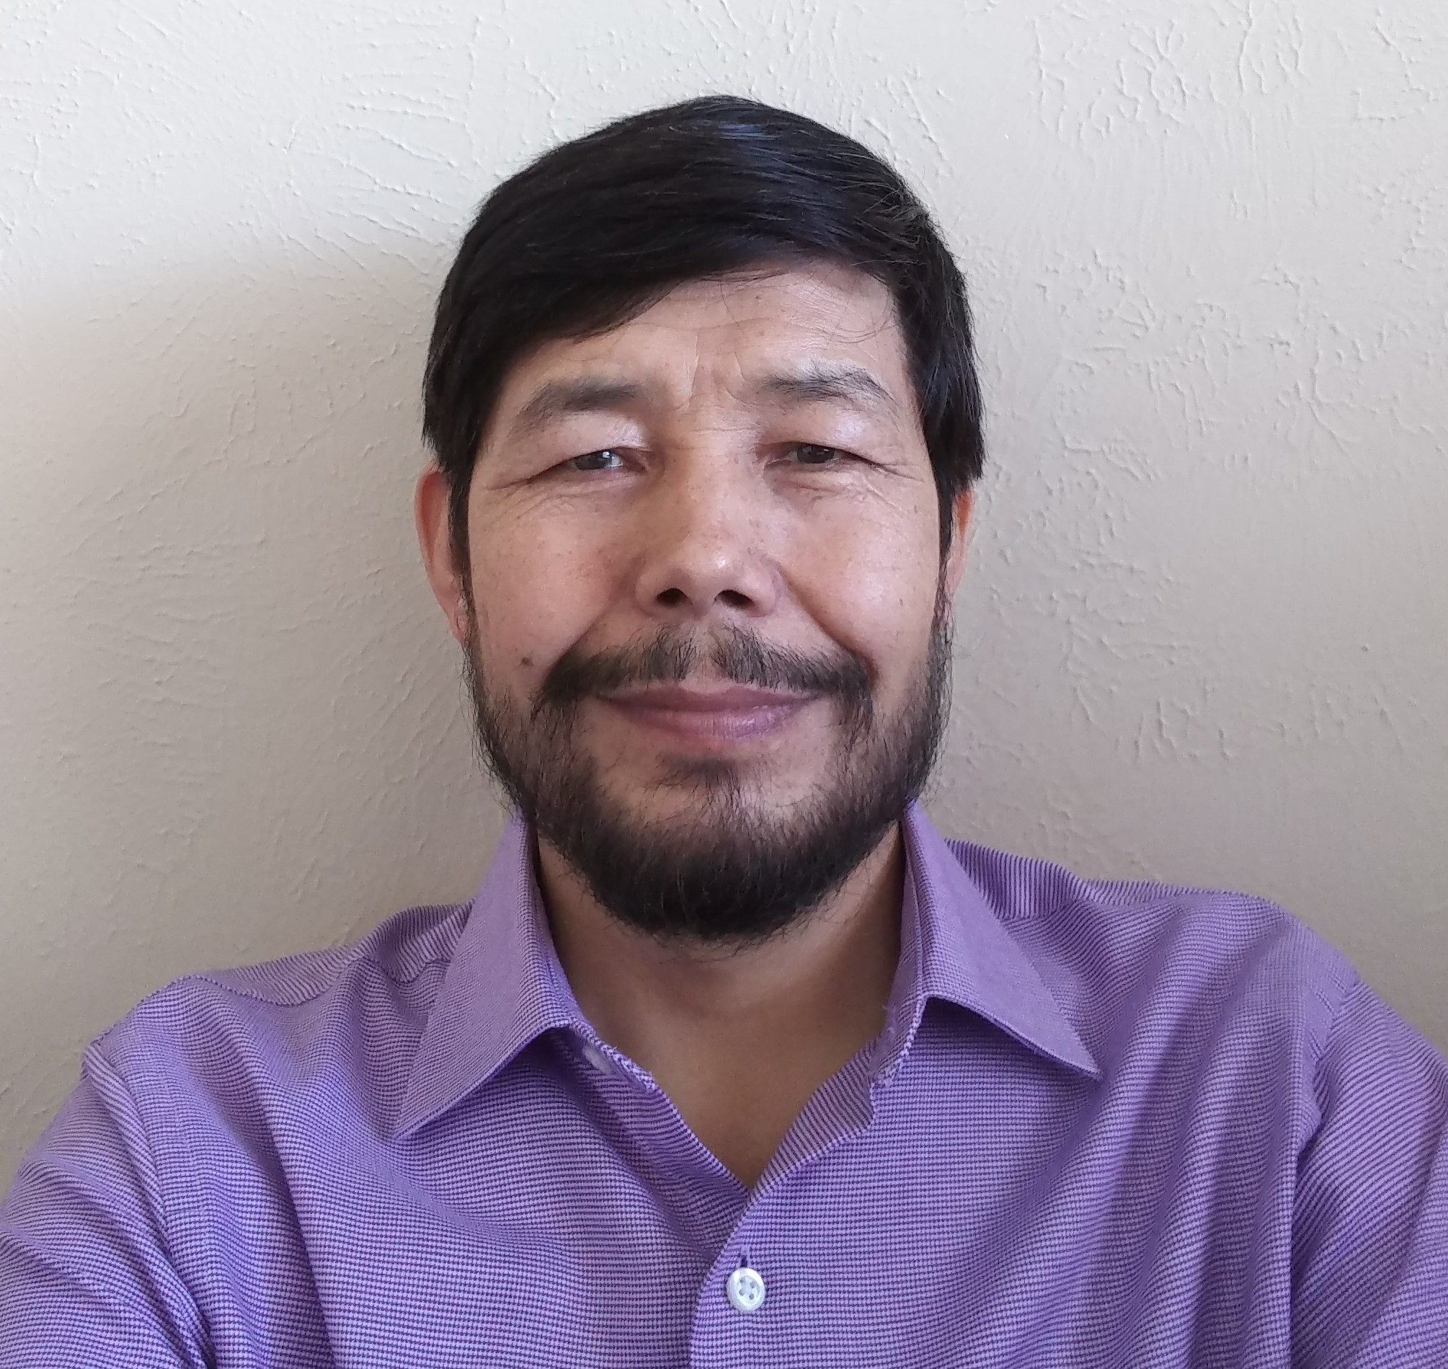

Everett McCrea
Software Engineering
Junior
Skills: Java, Cloud Computing
Job: Java Application Dev
Mohammad Asif
Software Engineering Junior
Skills: C++, Java
Job: Application Development
Luke Padgett Software Engineering Junior Skills: Java, Javascript
Job: Enterprise Java Dev
Dylan Capece
Software Engineering
Senior
Skills: Java, C++
Job: Application Development
Blake Stroud
Software Engineering
Senior
Skills: C++/C, Python
Job: Embedded Systems Engineer

Slide 3
Project Overview
App that shows real-time map of UTD parking availability
Track open spaces via car sensors and antennas at entrance of parking lot
Report number of cars in a lot to host system, then report to users
Track cars leaving parking lot
Detect which parking sticker cars have
Fix the UTD parking problem

Slide 4
Business Value
Save time and fuel
Less pollution
Increase end user satisfaction
Can charge a small fee
$2 a per week

Slide 5
Why Us
We have the necessary technical skills
Engineering and Computer Science majors
Motivated to fix a issue that affects us personally
Desire to improve the student experience
Knowledgeable of what the key issues are
Understand the potential that we can achieve with this service

Slide 6
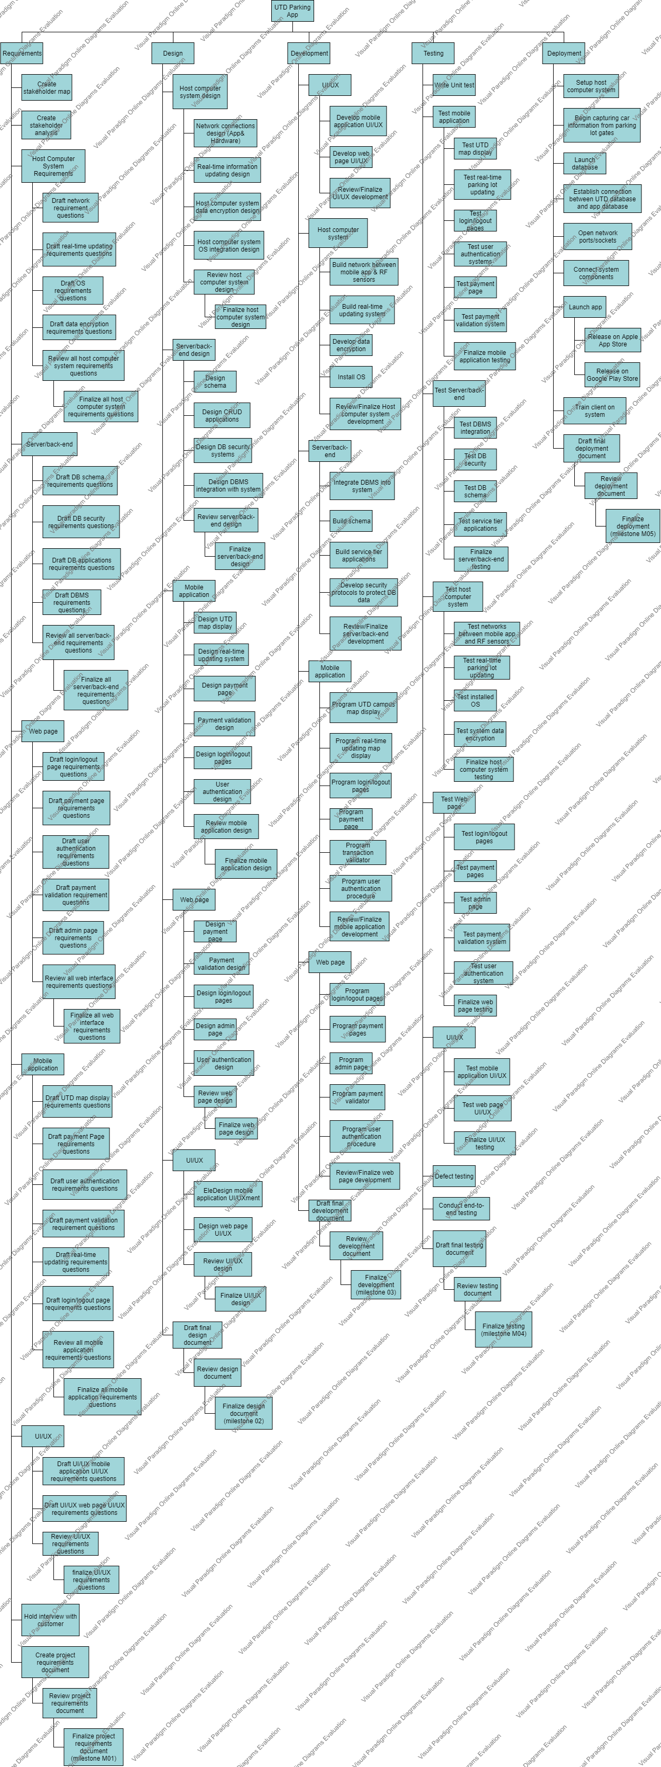
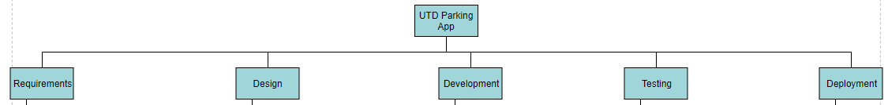
Work Breakdown Structure
Broken down into 5 stages of software lifecycle
Requirements, Design, Development, Testing, Deployment

Slide 7
WBS: Requirements
Mobile app
Web page
Server/back-end
Host computer system
UI/UX
Get information about what the client wants out of the system
Broken down into functional areas

Slide 8
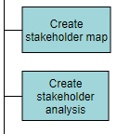
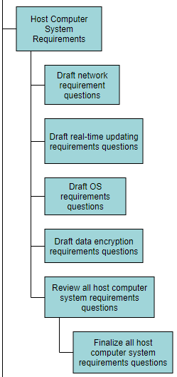
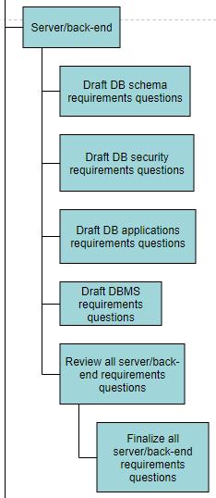
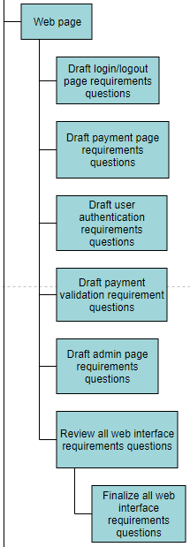
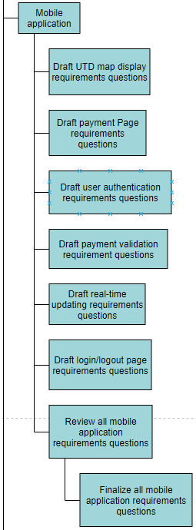
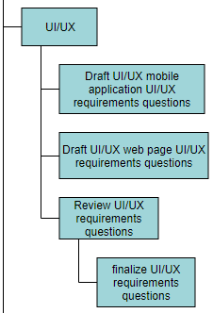
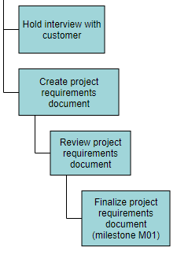
WBS: Requirements

Slide 9
WBS: Design
Host comp. system
Mobile app
UI/UX
Server/back-end
Web page
Design what is important to end users
Design essential architecture for system to work

Slide 10
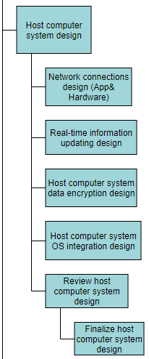
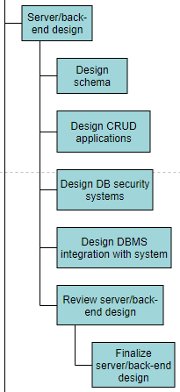
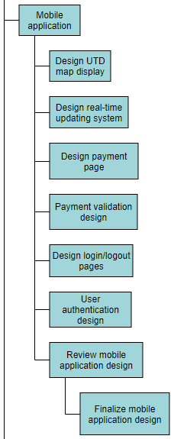
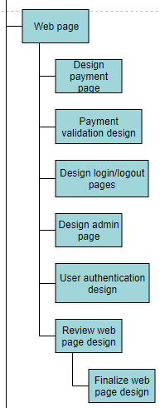
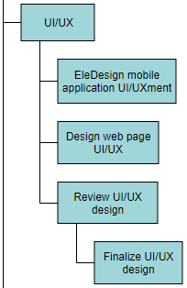
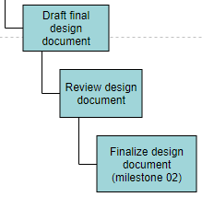
WBS: Design

Slide 11
WBS: Development
Host computer system
Web page
Server/back-end
Mobile app
UI/UX
Find parts that need to be built
Determine which functionalities they need
Adherence to requirements

Slide 12
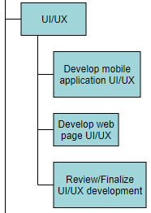
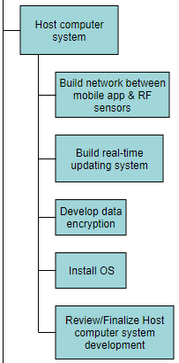
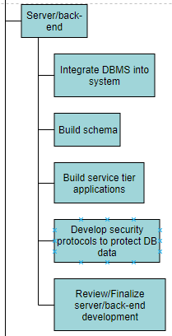
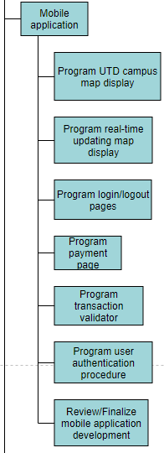
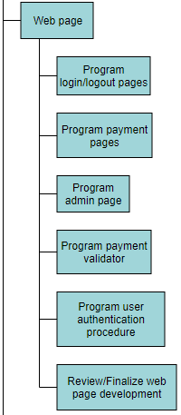
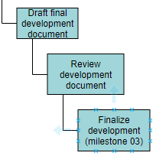
WBS: Development

Slide 13
WBS: Testing
UI/UX
Host computer system
Server/back-end
Web page
Mobile app
Unit tests, end-to-end tests, error detection
Find any issues with the system
Ensure system is secure
Ensure system won’t collapse under high usage

Slide 14
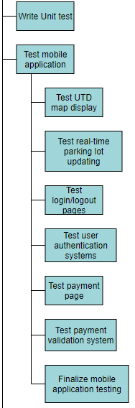
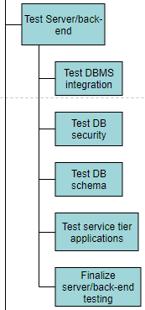
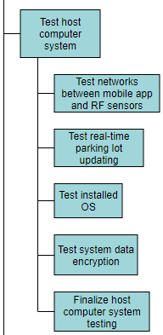
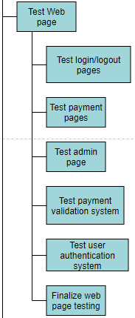
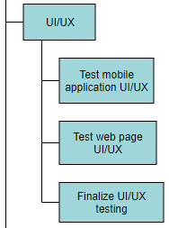
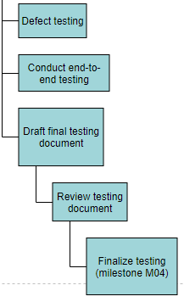
WBS: Testing

Slide 15
WBS: Deployment
Launch app
Connect UTD database and app database/launch new database
Host computer system setup
Establish network connections
Training
Launch DB
Ensure everything is in place for launch day
All systems connected together
Make sure users have functionality

Slide 16
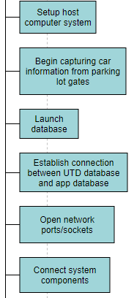
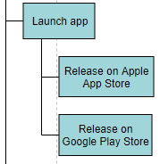
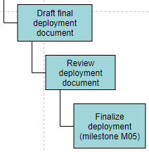
WBS: Deployment

Slide 17
Pricing Milestones
Wages based of average of appropriate engineering position in Dallas, TX
Development costs mostly come from back-end, host computer system, and mobile application development
Time to build estimated around 270 days
Based on average length of medium-sized software project
Milestone | Price(USD)
Requirements (M01) | $100,000
Design (M02) | $200,000
Development (M03) | $800,000
Testing (M04) | $400,000
Deployment (M05) | $150,000
Total: | $1,650,000
Initial top-down estimate

Slide 18
Pricing Milestones
1.35 mark-up
Time to build less than original estimate (211 days)
Development cost drastically overestimated prior
Includes employee benefits
Team of 41 employees
Including PM
Milestone | Price(USD)
Requirements | $117,819
Design | $83,060
Development | $264,632
Testing | $247,452
Deployment | $108,272
Total: | $821,235
Milestone | Price(USD)
Requirements | $159,055
Design | $112,131
Development | $358,765
Testing | $310,506
Deployment | $146,167
Total: | $1,086,624
Bottom up cost
Bottom up price

Slide 19
Key Risks & Issues
Risks:
Design of host computer system may be late by 3 days
Design of mobile application may be late by 3 days
Final design document may be late by 3 days
Issues:
Interview questions not complete on time, requirements interview with client is pushed back

Slide 20
Decisions & Actions
Decisions:
Requirements interviews conducted with all of the requirements team
Client will review deliverables of project monthly
Actions:
Start development of system's functional components once their design documents are finalized
Start testing of system's components as soon as their development is finalized
Have appropriate team lead participate in the review and finalization of deliverable documents
Contact development engineer lead each week to check in on progress

Slide 21
RMP Flowchart
Is it a risk?
Submit potential risk
Project manager evaluation
NO
Disregard
end
start
YES
Put on RAID sheet
Evaluate risk threat
Assign risk to a task(s) or action
What type of risk?
SCOPE
BUDGET
SCHEDULE

Slide 22
RMP Flowchart
Does the risk originate from the client?
NO
SCOPE
Take task(s) out of schedule
YES
Have client submit formal change request
end

Slide 23
RMP Flowchart
Is there enough slack to compensate?
Monitor task progression to ensure it does not fall behind schedule further
NO
YES
end
SCHEDULE
Set up meeting with appropriate team leads
Determine severity of impact to schedule
Can a subcontractor be hired to expedite work?
Hold meeting with team leads explaining impact to schedule and brainstorm ways to solve issue in other project phases
NO
Is it on the critical path?
NO
end
YES
YES
Contact appointed supervisor to explain situation
end
Meet with responsible employee(s) and hand-off employee(s) to discuss risk
Have employee(s) work overtime/weekends until caught up
YES
Can the task be laddered enough to ensure dependencies do not run late?
What is lacking to cause task to run late?
Is/are employee(s) willing to work overtime or weekends?
Are internal employees able to help with workload?
Ladder task deliverables so that dependencies start early
NO
YES
NO
TIME
NO
Meet with appropriate team lead to explain situation.
Hire subcontractor and update budget
end
end
RESOURCES
YES
Are you able to secure required resources?
Shift employee(s) around to ensure risk does not become issue
Put in order for required resources and deliver when ready
YES
end
NO
end

Slide 24
RMP Flowchart
end
Get updated price and update project budget accordingly
Order from new supplier and update budget accordingly
end
YES
YES
end
Can you negotiate an acceptable price?
Are there cheaper alternatives?
Discuss matter with appointed supervisor and come up with resolutions
end
NO
NO
Update budget appropriately and monitor risk
Can the task(s) duration be reduced?
YES
Reduce duration of task to save on employee costs
end
SUPPLIES
Determine severity of impact on budget
NO
Will the risk make cash flow negative?
What is the risk coming from?
NO
TASKS
Can either predecessors or dependencies be reduced?
YES
Set up meeting with appropriate team leads
NO
Discuss matter with appointed supervisor and come up with resolutions
Are reserve funds available?
end
NO
Pull money from reserves to cover costs
YES
YES
Update budget
BUDGET
end

Slide 25
RMP Table
Flow step | Details
Submit potential risks | Employee or PM must submit potential risk for PM's consideration
Project manager evaluation | PM reviews risk
Is it a risk? | PM determines if the potential risk is an actual risk
Disregard | If the potential risk does not turn out to be a risk, disregard the concern
Put on RAID sheet | If potential risk is real, write it down on the RAID sheet
Evaluate risk threat | Evaluate which level of risk (low, medium, high) the risk falls under
Assign risk to a task(s) or action | Assign the risk to a specific item of work in the WBS or MPP schedule
What type of risk? | Determine if the risk deals with the scope, budget, or schedule of the project
Does the risk originate from the client? | If the risk deals with the scope, determine if this change in scope came from client
Take task(s) out of schedule | If the scope risk did not come from the employee, then it is not in the SoW, therefore do not continue working on it
Have client submit formal change request | If the scope risk came from the client, have them submit a change request so the project can be renegoiated
Set up meeting with appropriate team leads | If a risk is posed to either the budget or schedule, set up a meeting with the team lead in which phase the risk may impact
Determine severity of impact to schedule | With the team lead, come up with a way of quantifying the risk severity
Is it on the critical path? | If the risk impacts the schedule, determine if the risk imapcts the critical path
Meet with responsible employee(s) and hand-off employee(s) to discuss risk | If on the critical path, meet with the employees working on the task
Is there enough slack to compensate? | If the task is not on critical path, determine if the provided slack is enough
Monitor task progression to ensure it does not fall behind schedule further | If enough slack is provided, keep an eye on risk to make sure it does not become an issue
Can the task be laddered enough to ensure dependencies do not run late? | If the task is on critical path, can the tasks be laddered so dependencies are not impacted as much
Ladder task deliverables so that dependencies start early | If it can be laddered, ladder the activity.
What is lacking to cause task to run late? | Determine what is causing the task to run late (supplies or time)
Are you able to secure required resources? | Determine if resource acquisition is possible to help expedite the task at hand
Put in order for required resources and deliver when ready | If the PM can get resources to remove risk, do so
Is/are employee(s) willing to work overtime or weekends? | If risk is associated with time, determine if employees will work more (overtime) to compensate

Slide 26
RMP Table
Have employee(s) work overtime/weekends until caught up | If employees are willing to work more (overtime), have them work extra hours
Are internal employees able to help with workload? | If employees are not willing to work extra, determine if there are more employees on the project that are able to help
Reorganize employees to ensure risk does not become issue | If there are employees on the project able to help, send them to work on the risk task
Can a subcontractor be hired to expedite work? | If there are no employees able to help work on risk task, determine if hiring a subcontractor will correct the risk
Meet with appropriate team lead to explain situation. | If a subcontractor can be hired, first meet with team leads to explain situation
Hire subcontractor and update budget | Hire a subcontractor and report budget changes
Hold meeting with team leads explaining impact to schedule and brainstorm ways to solve issue in other project phases | If you cannot hire a subcontractor, meet with all the project phase team leads to come up with a solution
Contact appointed supervisor to explain situation | PM should contact their boss to report the situation
Set up meeting with appropriate team leads | If the risk is associated with the budget, meet up with appropriate team lead impacted by risk
Determine severity of impact on budget | Determine the risk's impact on the project budget
Will the risk make cash flow negative? | Determine if the risk makes the cash flow of the project run into the negatives
Update budget appropriately and monitor risk | If the risk does not make cash flow negative, update the budget according to risk cost and monitor it so it does not get too severe
Are reserve funds available? | If the cash flow becomes negative, are there reserved funds you can use to combat the risk?
Pull money from reserves to cover costs | If reserve funds are available, pull money from reserve to deal with risk
Update budget | Update the budget to reflect the risk's impact
What is the risk coming from? | If there are no reserve funds, determine if risk is coming from supplies or tasks
Can you negotiate an acceptable price? | If risk is coming from supplies, is it possible to get a bargain
Get updated price and update project budget accordingly | If you can get a bargain, take deal and update budget
Are there cheaper alternatives? | If a bargain cannot be negotiated, are the other supplies that are cheaper to purchase
Order from new supplier and update budget accordingly | If cheaper supplies exist, buy those instead and update budget
Discuss matter with appointed supervisor and come up with resolutions | If no cheaper supplies exist, discuss the matter with PM's supervisor
Can the duration of the task(s) be reduced? | If risk is coming from tasks, determine if overall duration of task can be reduced
Reduce duration of task to save on employee costs | If the duration of the task can be reduced, reduce it as to save money on employee costs
Can either predecessors or dependencies be reduced? | If the task cannot be reduced, can either its dependent tasks or preceeding tasks be reduced
Discuss matter with appointed supervisor and come up with resolutions | If neither preceding or dependent tasks can be reduced, discuss matter with PM's supervisor

